Slide 1
T1-T2 mapping of butter and vegetable oils
NMR and MRI Application in Biotechnology

Slide 2
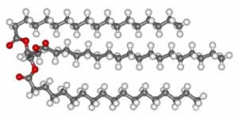
Fats and Oils
Fats and oils are lipid materials derived from animals and plants.
Physically, oils are liquid at room temperature, and fats are solid.
Chemically, both fats and oils are composed of triglycerides.

Slide 3
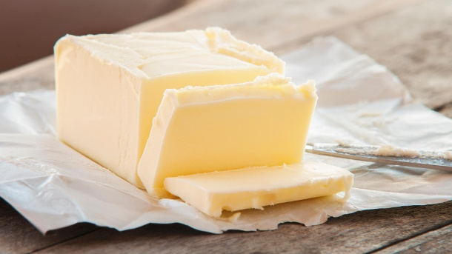
Butter
Butter is a water-in-oil emulsion resulting from an inversion of the cream, where the milk proteins are the emulsifiers.
Butter remains a firm solid when refrigerated, but softens to a spreadable consistency at room temperature, and melts to a thin liquid consistency at 32 to 35 °C

Slide 4
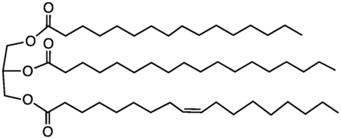
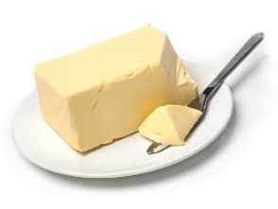
Butter
% | Butter Chemical composition- FA
11 | 12:0
12 | 14:0
31 | 16:0
4 | 16:1
11 | 18:0
24 | 18:1
3 | 18:2
1 | 18:3
3 | Other

Slide 5
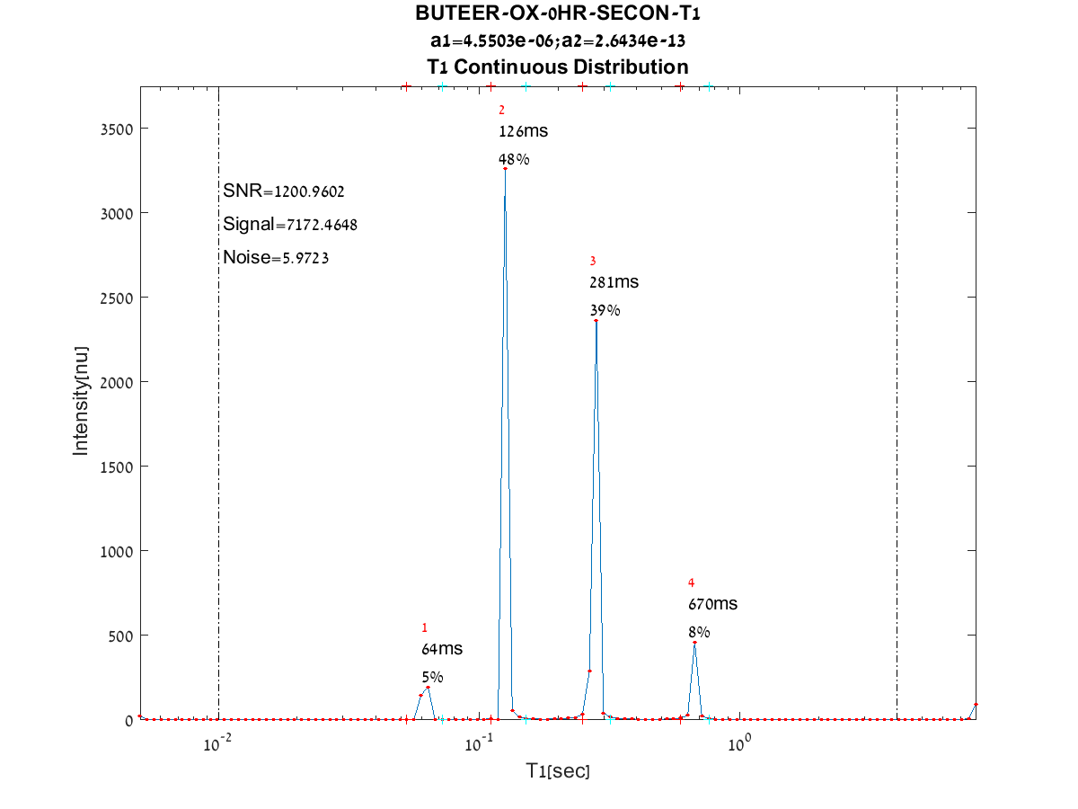
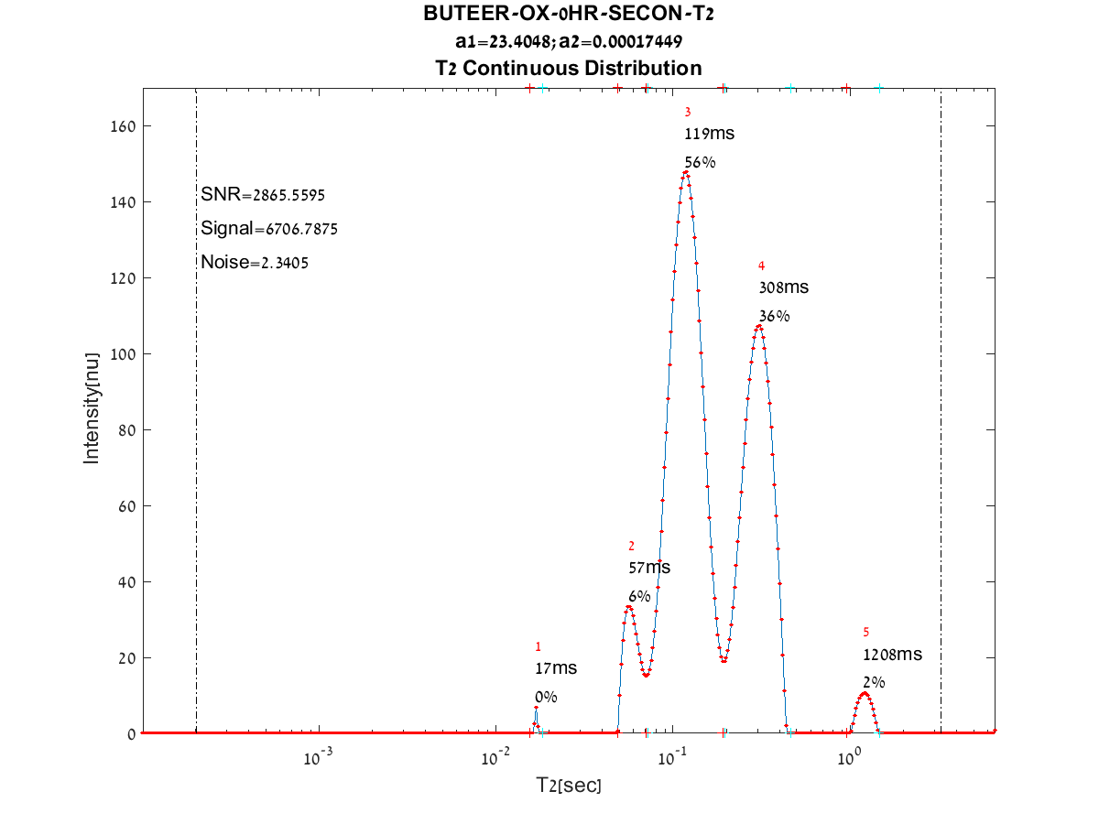
1D relaxation time spectra of Butter
T1 relaxation time spectrum of butter
T2 relaxation time spectrum of butter

Slide 6
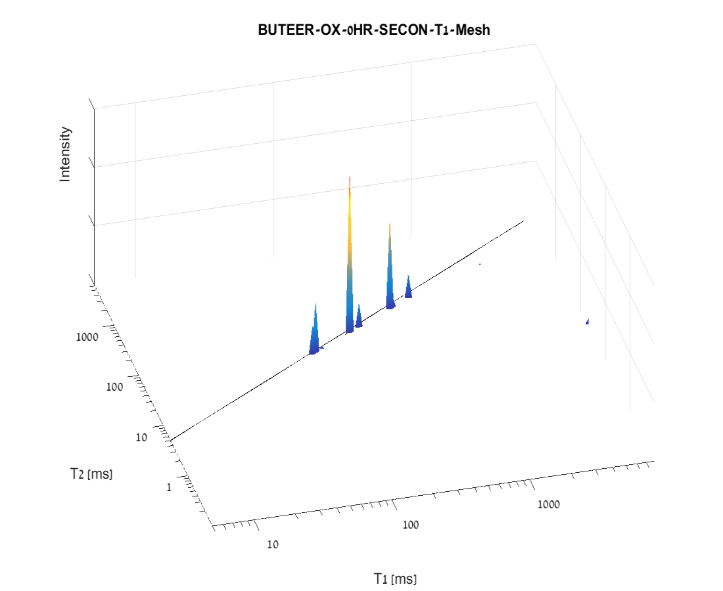
Butter

Slide 7
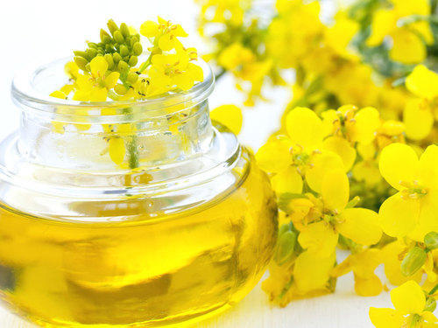
Rapeseed Oil
Rapeseed is the third-largest source of vegetable oil in the world, after soyabean and palm oil.
Rapeseed is used to make biodiesel, margarine, animal feed, and bioplastics.
It is pollinated by honeybees and the honey is mixed with other types or sold as bakery-grade.
Rapeseed oil is the preferred oil stock for biodiesel production in most of Europe, accounting for about 80 percent of the feedstock, partly because rapeseed produces more oil per unit of land area compared to other oil sources, such as soybeans, but primarily because canola oil has a significantly lower gel point (lower temperature for freezing) than most other vegetable oils.

Slide 8
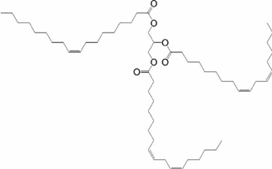
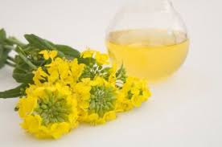
Rapeseed Oil
% | Rapeseed Oil Chemical composition- FA
5 | 16:0
1 | 16:1
2 | 18:0
64 | 18:1
20 | 18:2
4 | 18:3
4 | other

Slide 9
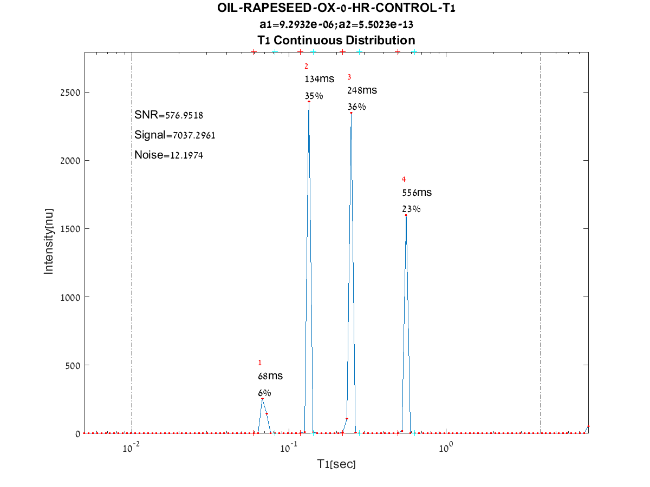
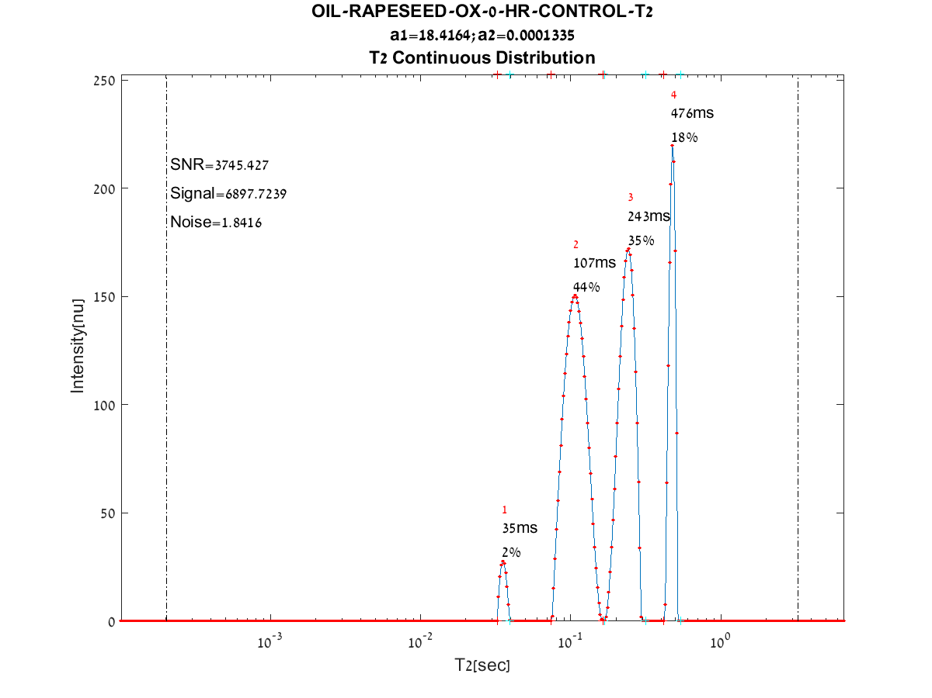
1D relaxation time spectra of Rapeseed oil
T1 relaxation time spectrum of rapeseed oil
T2 relaxation time spectrum of rapeseed oil

Slide 10
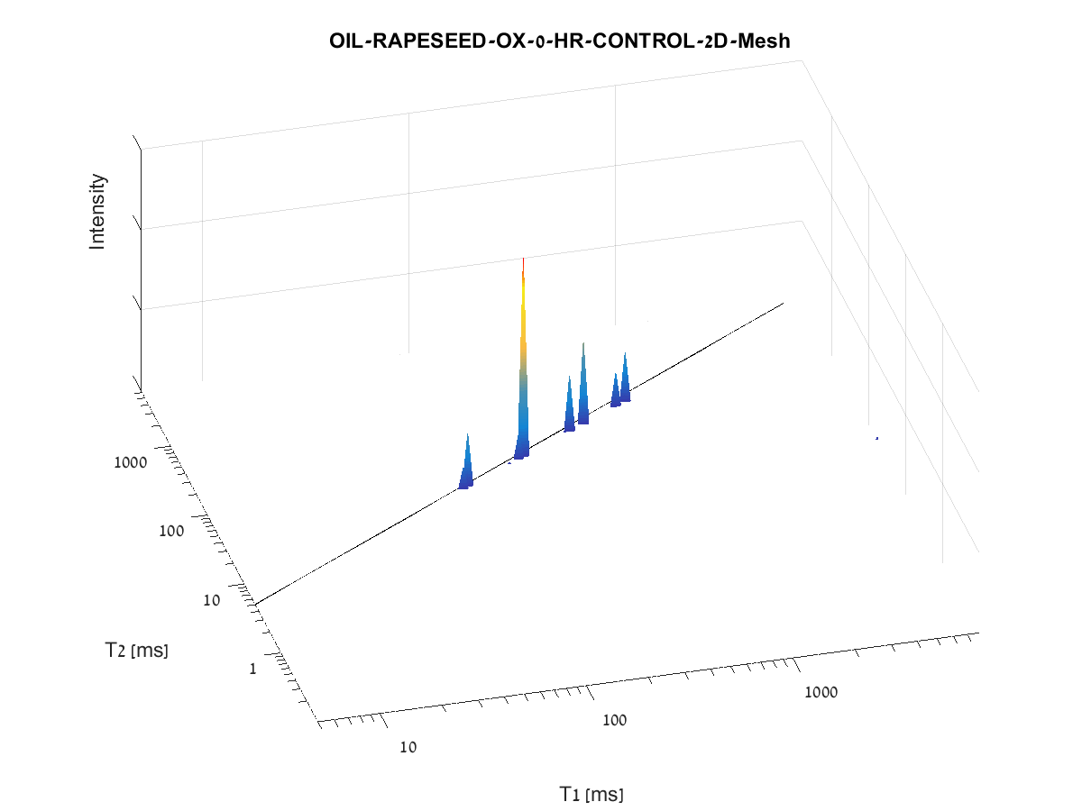
Rapeseed Oil

Slide 11
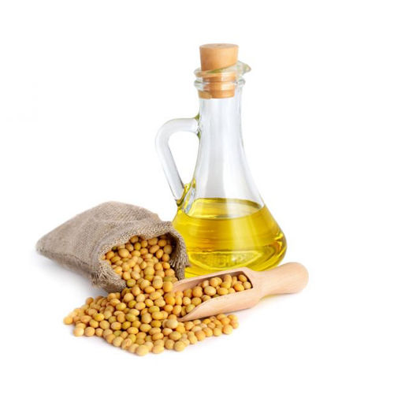
Soybean Oil
Soybean oil, a vegetable oil extracted from the seeds of the soybean (Glycine max), has an oil content accounting for around 22% of the dry seed.
Soybean oil is a major source of edible oil, fats and energy on a global scale. According to Soyatech estimates annual world production of soybean oil in 2009–2010 was 37.3 million metric tons.
It is cheaper than other oils, is readily available, and functions well in most food applications.
Soybean oil is considered a low saturated acid oil and is high in polyunsaturated acid content.
While highly desirable from a nutritional standpoint, the high amounts of polyunsaturated acids may present oxidative stability problems in some food applications where long shelf life is required.

Slide 12
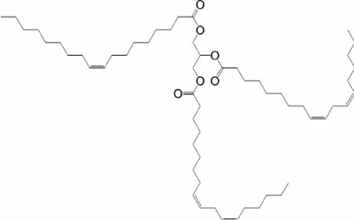
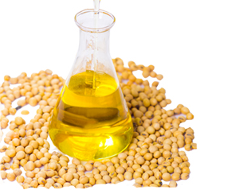
Soybean Oil
% | Soyabean Oil Chemical composition- FA
11 | 16:0
2 | 16:1
4 | 18:0
23 | 18:1
47 | 18:2
7 | 18:3
6 | other

Slide 13
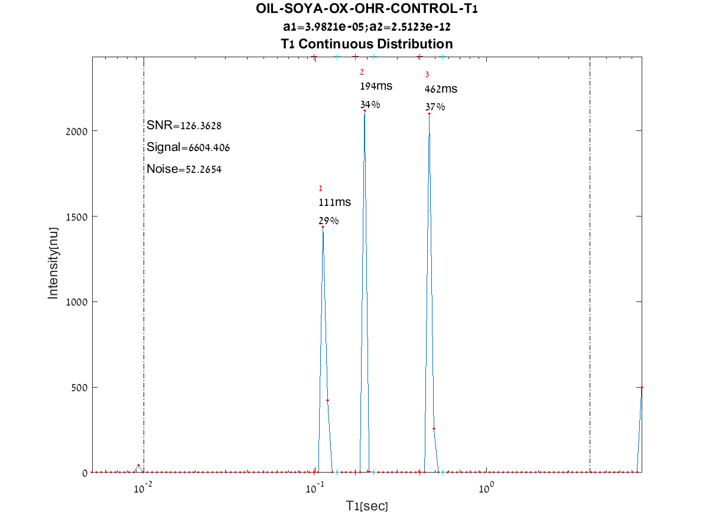
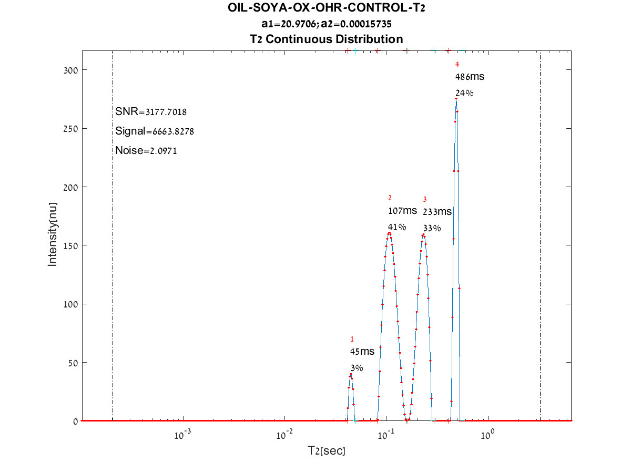
1D relaxation time spectra of soybean oil
T1 relaxation time spectrum of soybean oil
T2 relaxation time spectrum of soybean oil

Slide 14
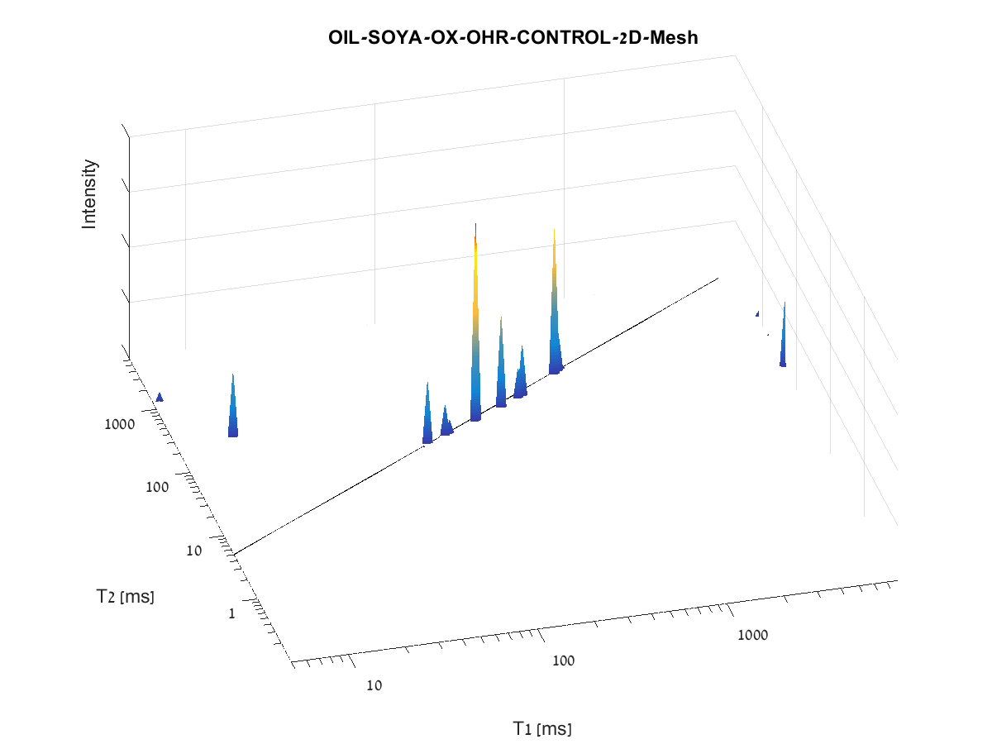
Soybean Oil

Slide 15
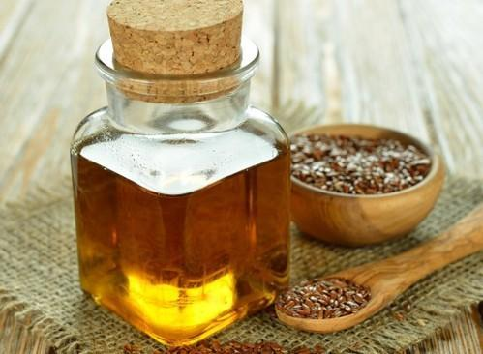
Linseed Oil
Linseed is an edible seed harvested from flax (Linum usitatissimum) plants. Consumed as food by the ancient Greeks and Romans, linseed has reemerged as a possible “superfood” because of its high dietary fibre and omega-3 fatty acid content. Previously, its main food use was as livestock feed.
Linseed oil is golden yellow, brown, or amber in color and has the highest level of α-linolenic acid (ALA) of any vegetable oil. Food-grade linseed oil is sometimes taken as a nutritional supplement and can be used in cooking, though it is unstable and goes rancid quickly. Industrially, it is classified as a drying oil because it thickens and becomes hard on exposure to air.
Linseed oil is one of the most useful natural oils. It is used as a preservative for wood, concrete, and an ingredient in paints, varnishes, and stains. As if that wasn't enough, it is also used in soaps, inks, and in the production of linoleum.

Slide 16
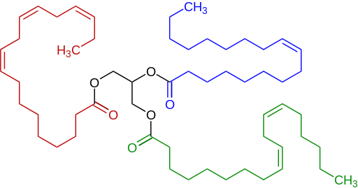
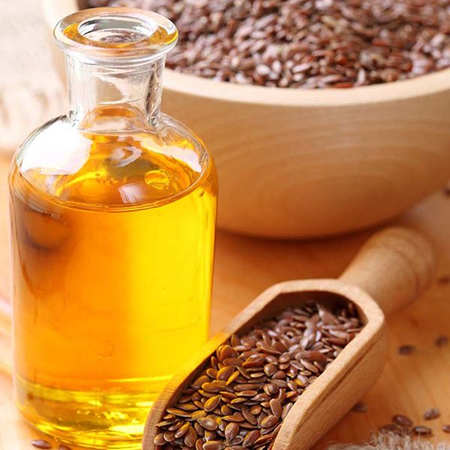
Linseed Oil
Linseed oil is known as a source of n-3 fatty acid, α- linolenic acid (ALA), constituting nearly 55% of total oil.
% | Linseed Oil Chemical composition- FA
4 | 16:0
1 | 16:1
4 | 18:0
20 | 18:1
15 | 18:2
54 | 18:3
2 | other

Slide 17
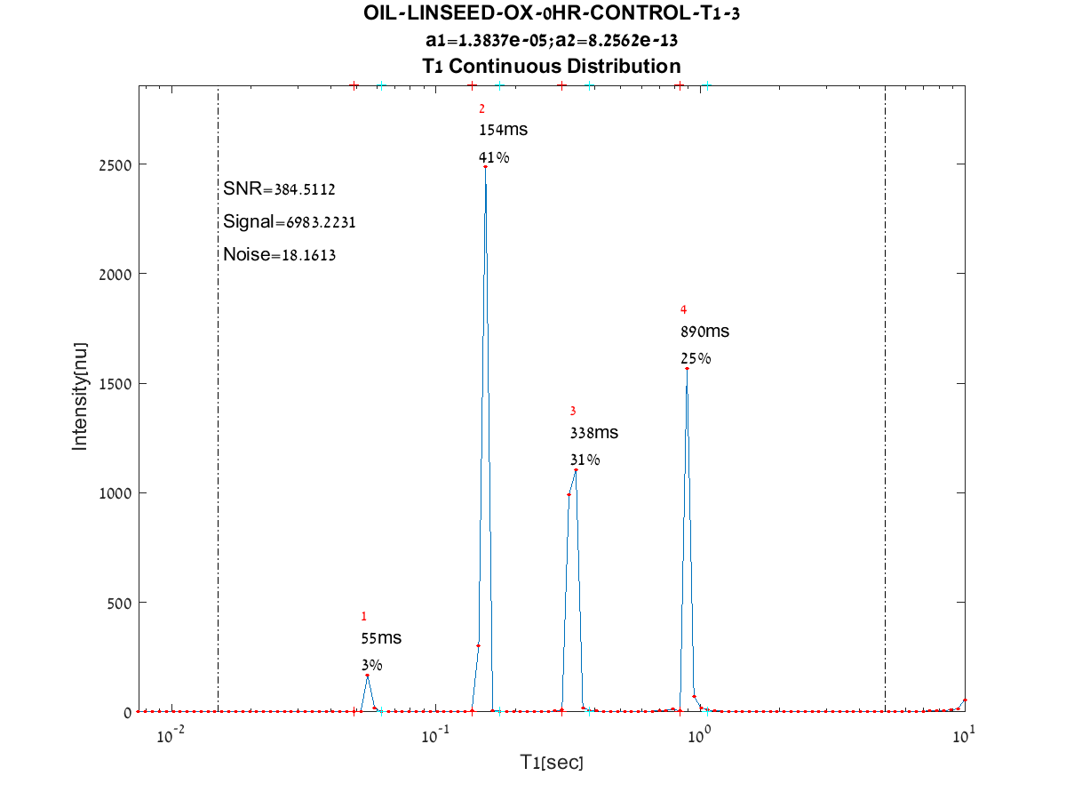
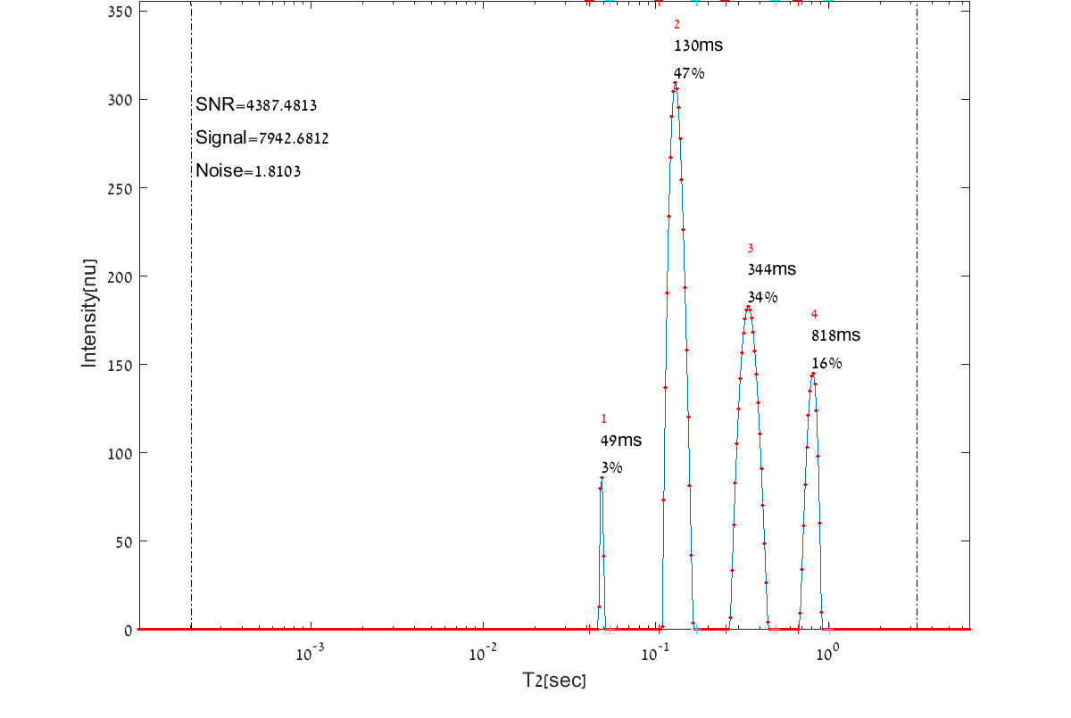
1D relaxtion time spectra of linseed oil
T1 relaxation time spectrum of linseed oil
T2 relaxation time spectrum of linseed oil

Slide 18
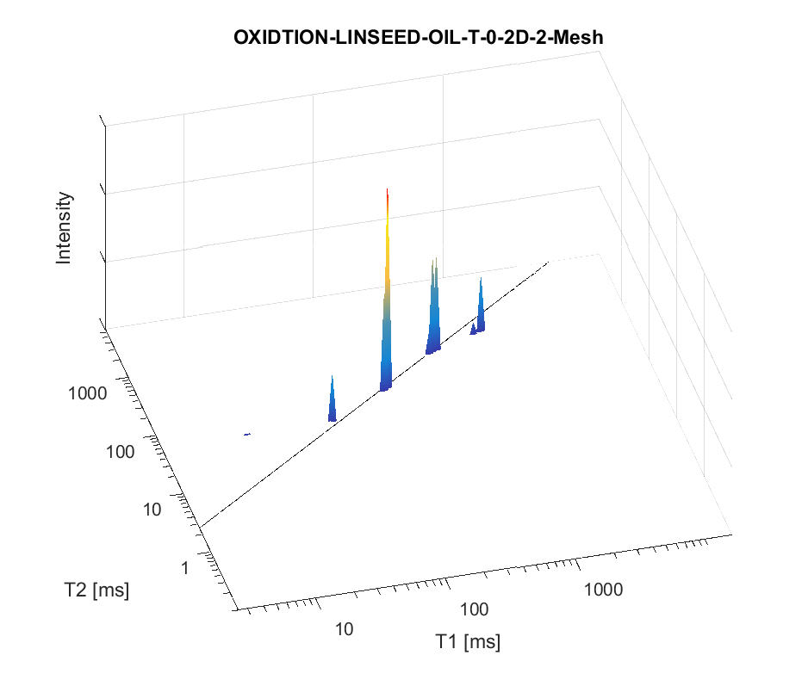
Linseed Oil
(2)
(3)
(4)
(1)

Slide 19
Contact Information
Prof. Zeev Wiesman: wiesman@bgu.ac.il
Maysa Resende: mteixeiraresende@gmail.com
Dr. Janna Abramovich: janna@bgu.ac.il
Shosh Kravchick: kravch@bgu.ac.il
Plant Lipid Biotechnology Lab phone number: 074-7795272

